Slide 1

PowerShell: Reuse & Extensibility
Bryan Cafferky
BPC Global Solutions LLC

Slide 2

Bryan Cafferky
@bryancafferky
bryan256@msn.com
Data Solutions Consultant and Trainer with BPC Global Solutions LLC
Microsoft MVP
Decades of IT experience
Author of Pro PowerShell for Database Developers by Apress
SQL PASS Chapter Lead
Lead the Southern New England UseR Group

Slide 3
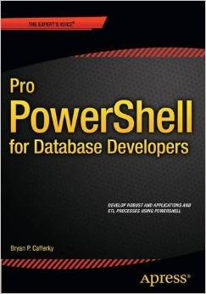
In-Depth Coverage of PowerShell Options and Configuration Features.
How to Create and Deploy Script Modules.
Advanced Functions that Inherit the PowerShell Common Parameters Support.
Reading and Writing to Databases.
How to Use PowerShell for Application Development.
Extensive Code Samples with Step by Step Walk Through.
Creating and Extending Custom PowerShell Objects.
Available on Amazon

Slide 4
What’s Ahead?
Reusability and Extensibility Using
Advanced Functions
Script Modules

Slide 5
What are Advanced Functions?
Cmdlets are written in a compiled or CLR language.
Advanced functions are written in PowerShell code but act like cmdlets.
More information:
https://4sysops.com/archives/powershell-advanced-functions-the-cmdletbinding-and-parameter-attribute/

Slide 6
Advanced Functions
CmdletBinding Attribute
Param Attribute
Enable PowerShell Common Parameter Support
Link for more information:
https://msdn.microsoft.com/en-us/powershell/reference/5.1/microsoft.powershell.core/about/about_functions_advanced_parameters

Slide 7
Reusability: Advanced Functions
function Invoke-UdfSpeech
{
[CmdletBinding()]
param (
[string]$speakit ='A default thing to say.'
)
Write-Verbose $speakit
$speaker = New-Object -com SAPI.SpVoice
$speaker.Speak($speakit, 1 ) | out-null
}
# Example of calling the function...
Invoke-UdfSpeech "PowerShell is awesome!"
Advanced function - CmdletBinding
Advanced function – param attribute
Common Parameter: -Verbose

Slide 8
Advanced Function Demo

Slide 9
Common Parameters
Parameter | Type | Description
Debug (alias: db) | Switch | Specifies whether programmer-level debugging messages that can be displayed at the command line.
ErrorAction (alias: ea) | Enumeration | Specifies what action should take place when an error occurs.
ErrorVariable (alias: ev) | String | Specifies the variable in which to place objects when an error occurs.
OutVariable (alias: ov) | String | Specifies the variable in which to place all output objects generated by the cmdlet.
OutBuffer (alias: ob) | Int32 | Defines the number of objects to store in the output buffer before any objects are passed down the pipeline.
Verbose (alias: vb) | Switch | Specifies whether the cmdlet writes explanatory messages that can be displayed at the command line.
WarningAction (alias: wa) | Enumeration | Specifies what action should take place when the cmdlet writes a warning message.
WarningVariable (alias: wv) | String | Specifies the variable in which warning messages can be saved.
Confirm (alias: cf) | Switch | Specifies whether the cmdlet displays a prompt that asks if the user is sure that they want to continue.
WhatIf (alias: wi) | Switch | Causes the cmdlet to writes a messages that describes the effects of running the cmdlet without actually performing any action.
UseTransaction (alias: usetx) | Switch | Specifies whether the cmdlet will use the current transaction to perform its action.

Slide 10
Extensibility: Script Modules
Serve as a function library.
Automatically located by PowerShell via $PSModulePath.
Simpliflies coding and deployment.

Slide 11
Extensibility: Script Module Features
Are completely written in PowerShell code.
Can have multiple functions in a script module.
Script has psm1 file extension.
Must be stored in a folder with the same name as the module.

Slide 12
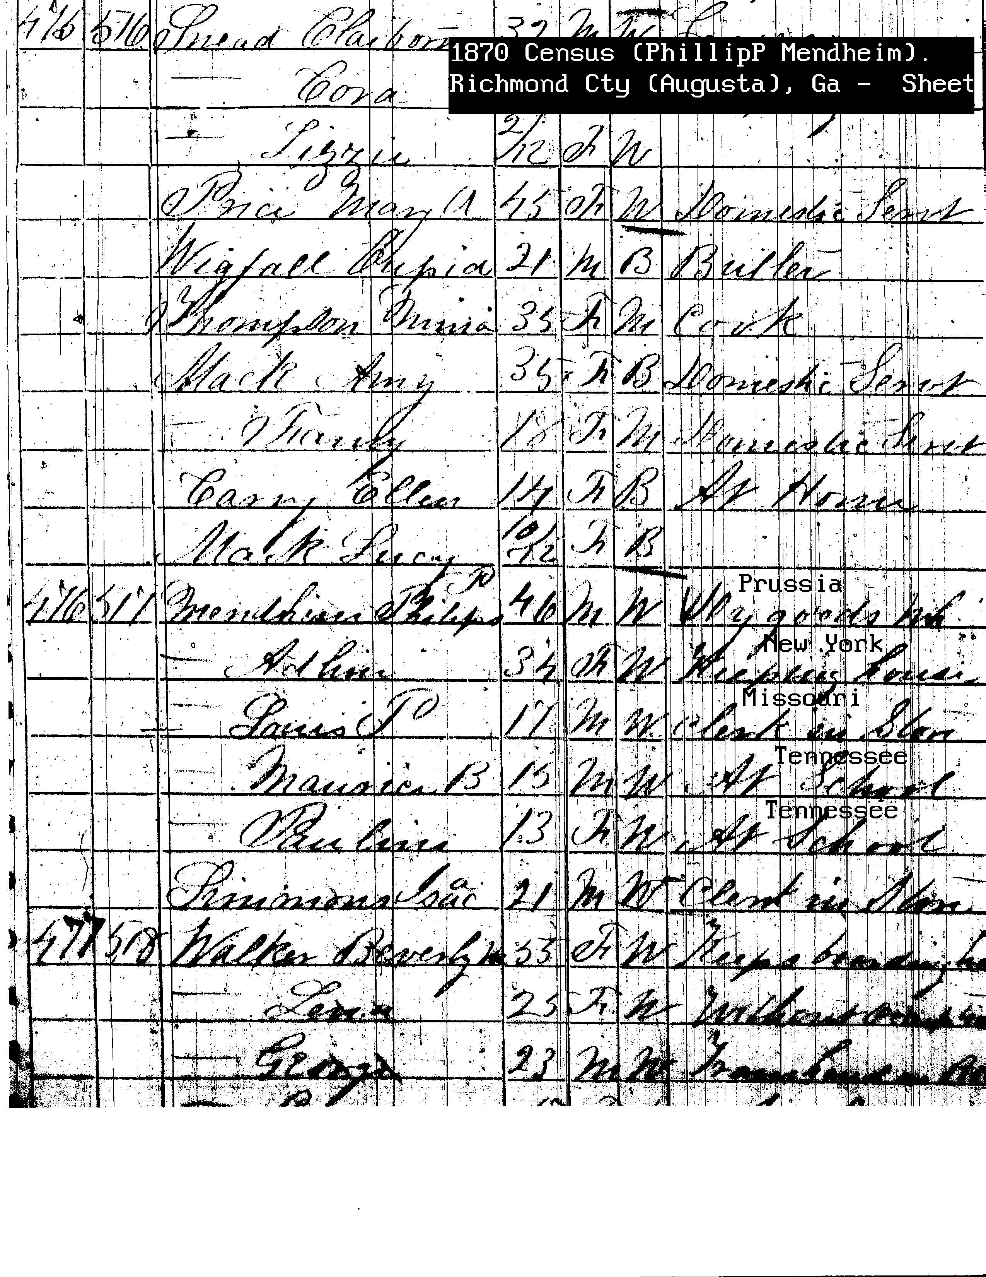

Extensibility: Module Manifest
Use New-ModuleManifest to create.
Document the module.
Not required.
Has the .PSD1 file extension.

Slide 13
Steps to Create a Script Module
Place in user’s Documents folder under \WindowsPowerShell\Module or any folder in $PSModulePath.
Create a sub folder with the name of the module.
Save the module script with the .psm1 extension.
To use enter: Import-Module ModuleName

Slide 14
Module Demo

Slide 15
Extensibility & Reuse Review: Advanced Functions
CmdletBinding Attribute
Param Attribute
Enable PowerShell Common Parameter Support

Slide 16
Extensibility: Script Module Review
Are completely written in PowerShell code.
Can have multiple functions in a script module.
Script has psm1 file extension.
Must be stored in a folder with the same name as the module.

Slide 17

Closing: Q & A

